Slide 1
Maimaiti Contest demo 09/25/2016
A P2P Lending Credit Model for
Chinese Overseas Students Loan Market

Slide 2




Team bio
LYLA YANG
Business Analyst
Origin Consulting, LLC
SHEN LI, CMA
Sr. Financial Analyst
Techstyle Fashion Group, Inc
WENHUAN WEI
Master Student
University of Washington
ZHAOHU FAN
PHD Student
Pennsylvania State University

Slide 3
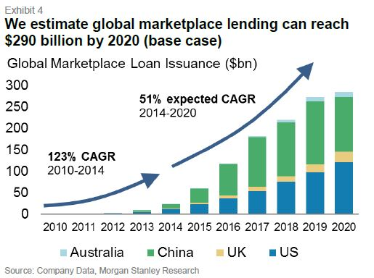
LENDING Market SIZE growtH
51% CAGR in lending market size
20% CAGR in customer base
Assume..
Total Customer acquisition Rate 10%
Average APR 5%
Average Loan per Customer $5,000/Year
Bad Debts Rate 2%
Annual Revenue Estimate: $4.5M

Slide 4
Customer nEEDS
Building credit history
Short term travel In US
Paying tuition and living cost
Buying a car

Slide 5







MARKET COMPETITION
Major P2P lending platform:
Traditional credit model based on FICO
Minimum credit score
3-5 years loan terms
Common use is credit card debt
Player in US college student loan niche market:
Based on alumni-funded lending model
Evaluate forward looking factors to determine borrower’s future potential
Use FICO as part of the credit rating process

Slide 6
Limitation of traditional credit model
Traditional Credit Model
Credit Utilization
New Credit
Types of Credit Used
Amount Owed
Length of Credit history
Payment History
However…Our target customer
Lack of Credit History
No fixed salary
WE HAVE NO INFORMATION TO RATE THEM THEN WHAT WE DO?

Slide 7

Do you feel like it is similar to…
IS HE/SHE THE RIGHT GUY/GIRL?
After chat how do you like him/her?
What are the information you care about? How to prove what he/she says?
So this is the same concept we will use in risk control process:
- Prove what he says(he is telling the truth)
- Evaluate qualification(he qualifies)

Slide 8
Attributes of the social network data
FIRST IMPRESSION?
Education
School, Major
Interest topic
Location
Origin, Current Location
Profession
Title, Salary, Industry
Relationship
family members
Personality
Social Connections, Popularity
• Content – Profile categorization, topic modeling, sentiment analysis, interest mining, etc.
• Context – Location, temporal analysis, behavior trajectory, community, etc.
• Connection – Relationship mining, core network detection.

Slide 9
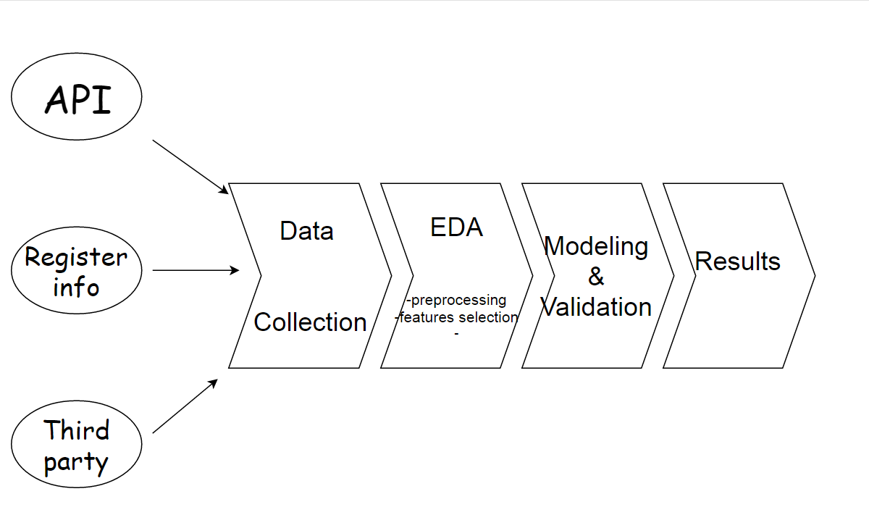
Credit rating Business process
Credit rating system

Slide 10


Credit rating model design process
Features Selection
Collect Data
Modeling
Lending Club
LASSO
80 Variables 》 10 Variables
A

Slide 11
source of data collected
Social data sets:
Current Location,
Education Experience,
Degrees,
Majors,
Grades,
Cell phone type,
Place of living,
Graduation Year,
Position Title,
Internships
Work Experience,
Traveling History,
Active social connections
Active social events
Etc
1000 single cases are collected
Lending Club:
Variable | Description
LOAN AMOUNT | The listed amount of the loan applied for by the borrower.
TOTAL FUNDING | The total amount committed to that loan at that point in time.
INVESTOR FUNDING | The total amount committed by investors for that loan at that point in time.
TERM | The number of payments on the loan. Values are in months and can be either 36 or 60.
INTEREST RATE | Interest rate on the loan.
INSTALLMENT | The monthly payment owed by the borrower if the loan originates.
INCOME | The annual income provided by the borrower during registration, measured in $1,000s.
DTI | A ratio calculated using the borrowers total monthly debt payments on the total debt obligations, excluding mortgage and the requested LC loan, divided by the borrower’s self-reported monthly income.
FICO | The average of the last upper and lower boundaries of the range of the borrowers FICO.
CHARGED OFF | An indicator variable equal to 1 if the borrower defaults on the loan and 0 otherwise.
Used Python BeautifulSoup4 and Selenium library and assign the collecting jobs in distributed mode to collect social network leads data

Slide 12
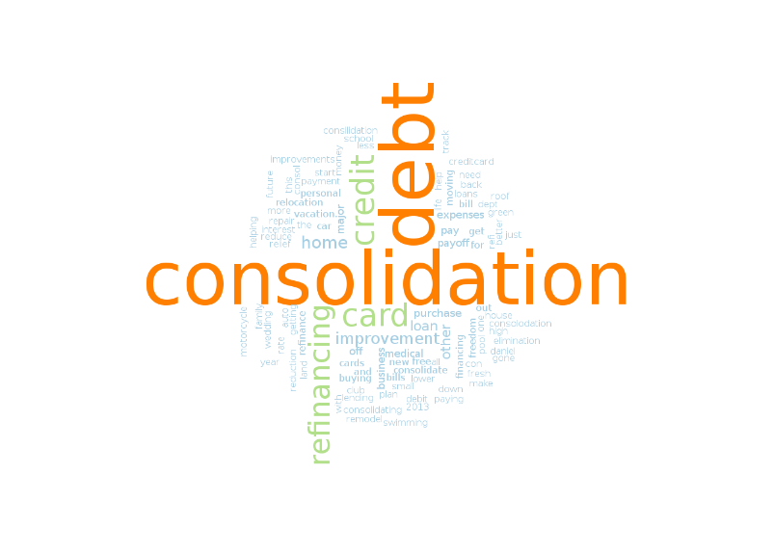
Categories of influential predictors
Credit history(if available)
FICO Score
Credit length
Education essentials
School tier
Major(Stem, non Stem)
Degree level
Ability to pay
Own car?
Account balance
Position title
Place of living
Past purchase transactions on Amazon
Social interaction
# of active connection
# of Places visited
Frequency of login and communication
Plot of world cloud - Loan Title

Slide 13
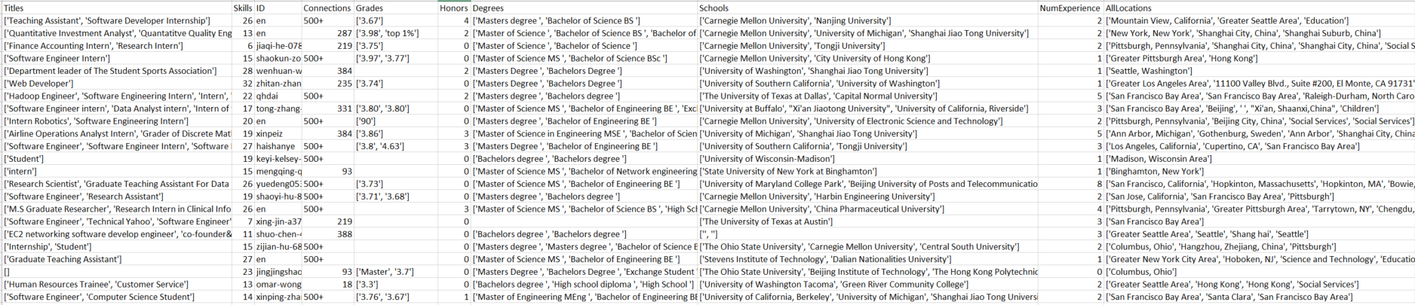
Sample social network Data Collected

Slide 14
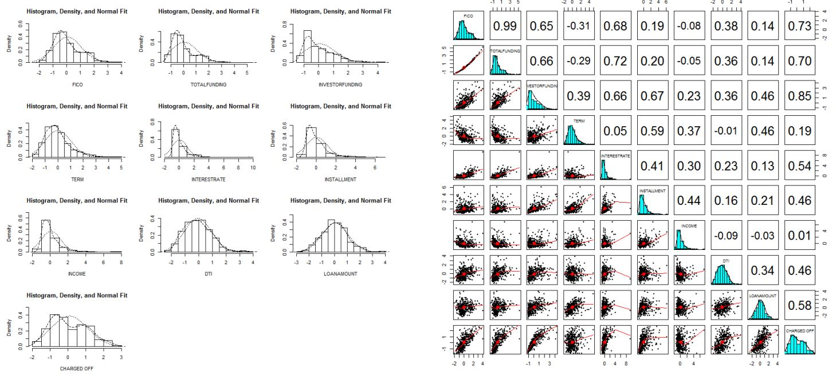
Exploratory Data Analysis
Figure 1: Plot of empirical distribution
Figure 2: Box plot of selected variables

Slide 15
Performance comparison
Machine Learning Methods | Mean Square Error | Speed
SVMs | ---------------- | Very Slow
RandomForestRegressor(max_depth=5) | 0.032 | Slow
xgb.XGBRegressor | 0.024 | Fast
MLR | 0.023
GradientBoostingRegressor | 0.026 | Fast
So MLR-Modified logistic regression model will be adopted.

Slide 16
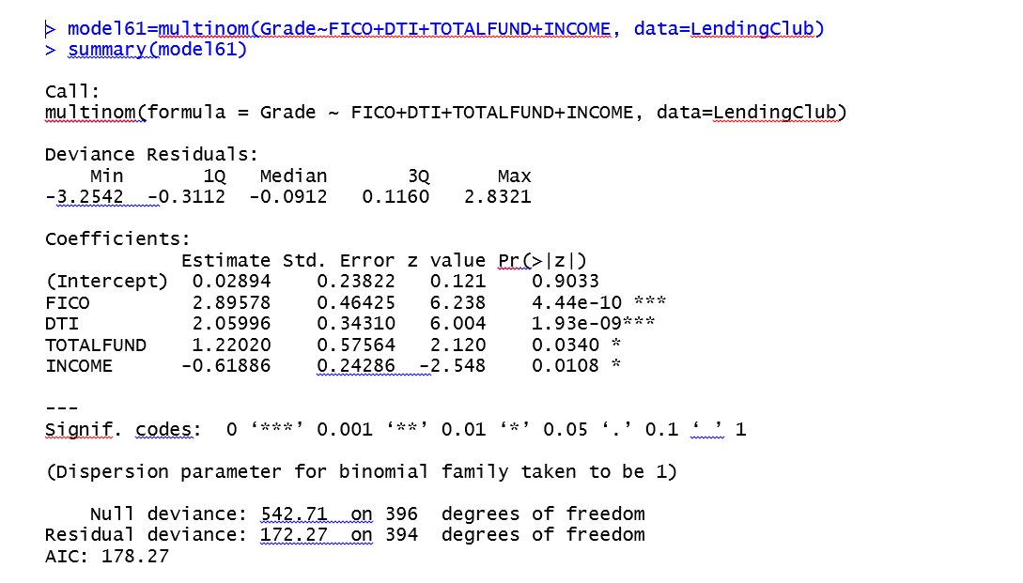
Final model
Final proposed model is given as follows(Logistic regression):

Slide 17
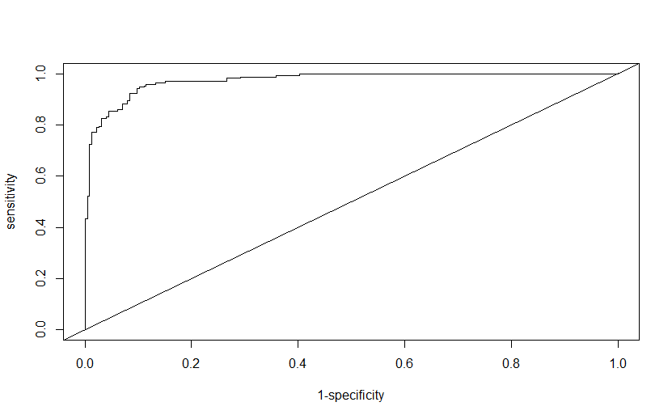
Model validation
The ROC curve is shown below. From the above output, the A value (i.e., Area Under the Curve) is 0.9745, indicating that the model has good predictive power.
Plot of ROC curve(receiver operating characteristic)

Slide 18
future model development
To reduce prediction error, we will split the data set into a training set (80%) and test set (20%). We build our model on the training set while comparing the predictive performance on the test set. We measure performance in terms of the root mean squared error, RMSE.
When there have been enough successful loan records of many students, we can generate more features of credit of a student from the real loan history of his own, we can modify this social media model to strengthen the scalability and enhance the reliability of our whole risk management system.
Collect additional data from online purchase history and utilities payment history

Slide 19
Additional plan on Risk Control
Other takeaways
The customer acquisition should focus on a group of selected attributes(Education, Major, Grades, etc)
Building Financial KPIs for credit model（Average loan amount, Average APR, average credit score, late payment, bad debt rate, etc）
Model need to be adjusted when sufficient loan data get collected
Collect borrower’s family information and Chinese personal identification
Alumni or Friends who has a credit score referral
Use social network API to track user’s real time update, major events, identify cross region fraud

Slide 20
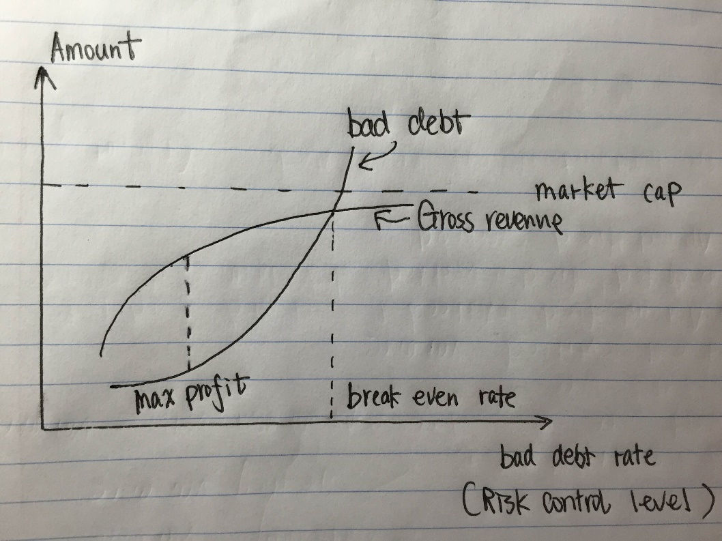
Relationship between risk level and profit
Max Profit point
Breakeven point
Build income projections based on credit model output

Slide 21
THANK YOU

